Slide 1


Programming in Java, 2e
Sachin Malhotra
Saurabh Choudhary

Slide 2
Chapter 14
Abstract Window Toolkit

Slide 3
Objectives
To use the set of GUI components
To use event-handling model for different components
To study layout managers, for flexible window layouts that don't depend on a particular window size or screen resolution

Slide 4
Introduction
The Java Foundation Classes (JFC) provide two frameworks for building GUI-based application and interestingly both rely on the same event handling model:
  AWT
  Swing
AWT relies on the underlying operating system on a specific platform to represent its GUI components (i.e components in AWT are called Heavyweight),
Swing implements a new set of lightweight GUI components that are written in Java and has a pluggable look and feel.
These lightweight components are not dependent on the underlying window system.

Slide 5
Components and Containers
A graphical user interface is developed with the help of graphical elements like
  buttons, scrollbars, lists, textfields, etc.
These elements are called components.
In AWT, these components are instances of the respective Component classes.
Components cannot exist alone; they are found within containers.
Actually, containers are themselves components, thus they can be placed inside other containers.
In AWT, all containers are objects of class Container or one of its subtypes.

Slide 6
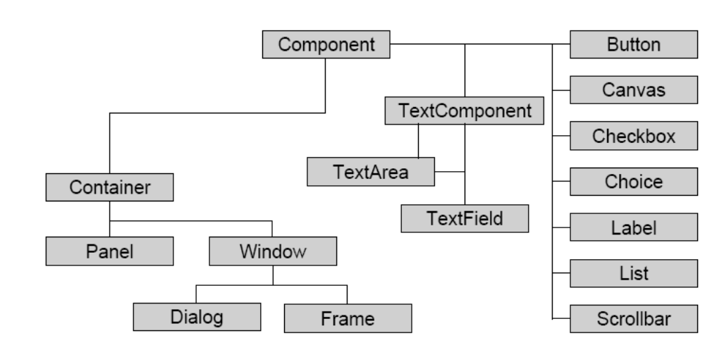
Hierarchy of classes in AWT

Slide 7
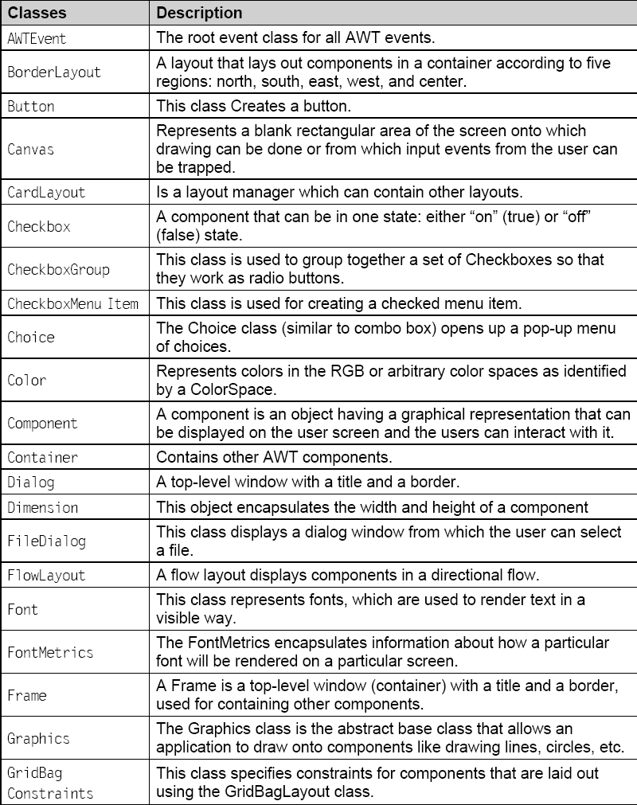
Few classes in AWT

Slide 8
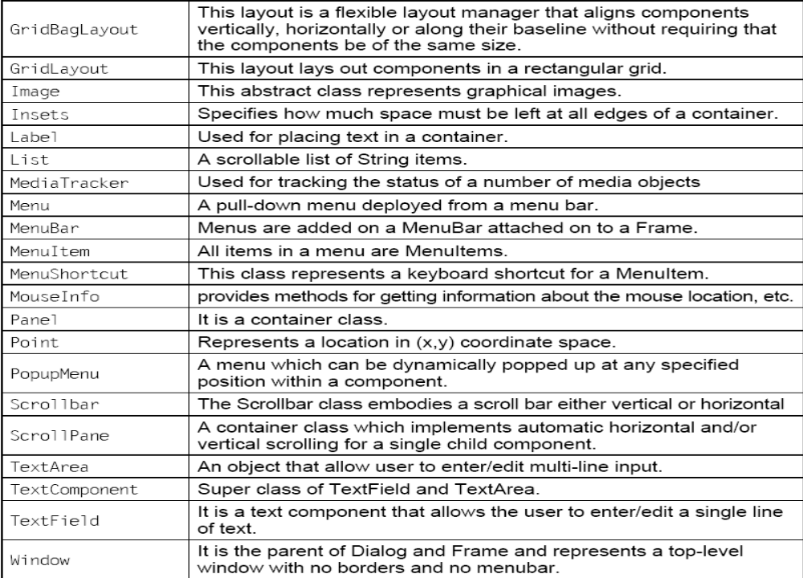
Few classes in AWT (contd.)

Slide 9
Component
subclass of the Object class & super class of classes such as
  Button,
  Label,
  CheckBox,
  RadioButton, Choice, Canvas, etc
Componenets are added to a window using the add() method
  Component add(Component ComObj)
  ComObj is the object of the Component, which is to be added
  This method returns the reference to the ComObj.
If you wish to remove a Component from a window, use remove() method
  void remove(Component ComObj)2

Slide 10
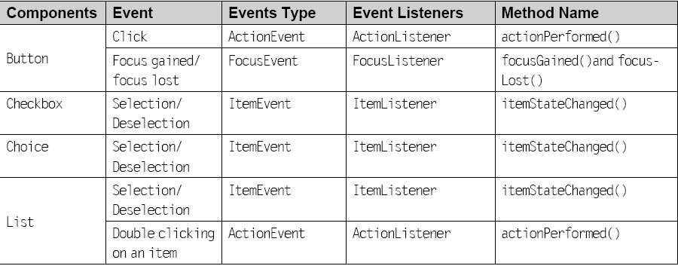
Components as Event Generator

Slide 11
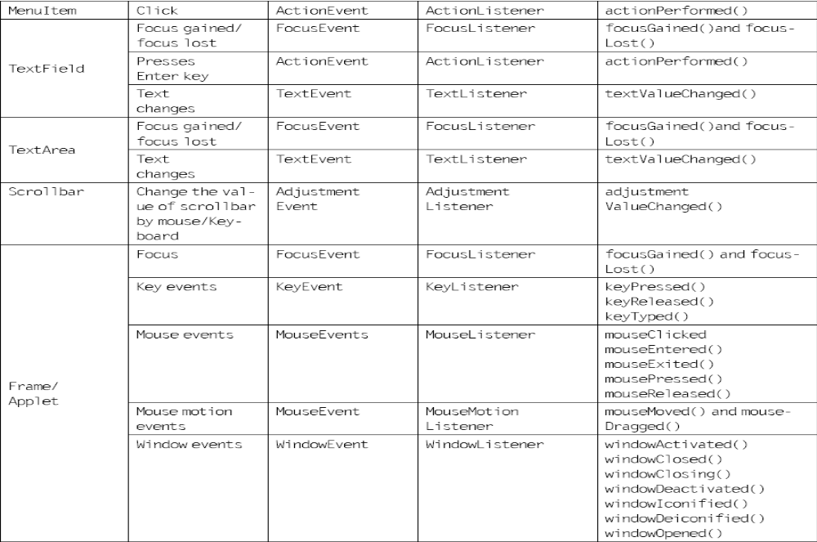
Components as Event Generator

Slide 12
Button
The Button class belongs to java.awt package
  public class Button extends Component implements Accessible
This class creates a button which when pushed or pressed generates an event.
The two constructors belonging to this Button class are:
  Button() throws HeadlessException
  Button(String str)throws HeadLessException;
To create a button
  Button buttonName = new Button(Str);
  ‘buttonname’ is the name you give to the button object and ‘Str’ is the text you want to appear on the button.
Once the object for Button is created, it needs to be added to the applet or any other container using
  add(buttonname);
  void setLabel(String str) for changing the button’s label
  String getLabel() for getting the Buttons label’s text

Slide 13
Button Example
/*<applet code=ButtonClass.class width=400 height=150></applet>*/
import java.applet.*;
import java.awt.*;
import java.awt.event.*;
public class ButtonClass extends Applet implements ActionListener{
Button red, white, blue;
Label hit;
public void init(){
red = new Button(“Red”);
white = new Button(“white”);
blue = new Button(“blue”);
hit = new Label(“Hit a Button to change the screen color”);
add(red); add(white); add(blue); add(hit);

Slide 14
Button Example (contd.)
red.addActionListener(this);
white.addActionListener(this);
blue.addActionListener(this);}
public void actionPerformed(ActionEvent ae){
String str = ae.getActionCommand();
if (str.equals(“Red”)) {
setBackground(Color.red);}
else if (str.equals(“white”)) {
setBackground(Color.white);}
else if (str.equals(“blue”)){
setBackground(Color.blue);}
repaint();}}

Slide 15
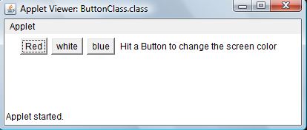
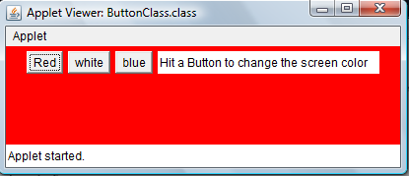
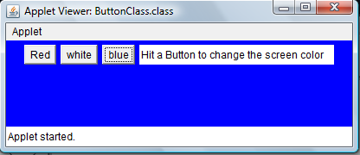
The Output

Slide 16
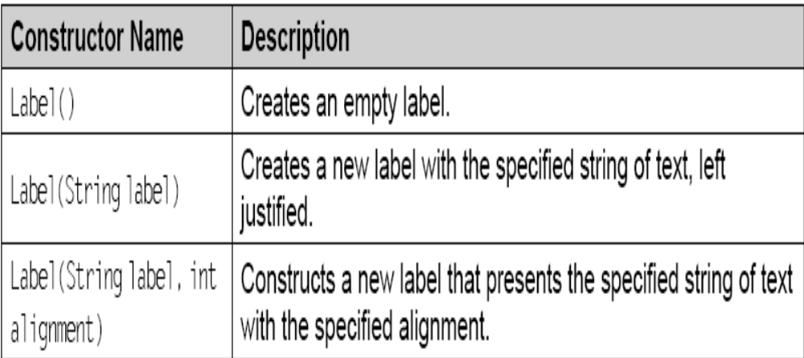
Label
Labels consist of a text string for display only and they never call an action method.
A Label can be justified LEFT, RIGHT, or CENTERED.
  new Label(“This label is for demonstration.”, Label.RIGHT);

Slide 17
Label Example
/*<applet code=”LabelClass” width=350 height=100></applet>*/
import java.applet.*;
import java.awt.*;
public class LabelClass extends Applet {
public void init(){
Label firstLabel = new Label(“Labels exist simply “);
add(firstLabel);
Label secLabel = new Label(“to place text on the screen”);
add(secLabel);
Label thirdLabel = new Label(“They can be aligned left, right or center.”);
add(thirdLabel);}}

Slide 18
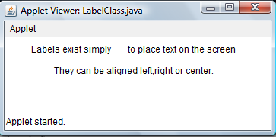
The Output

Slide 19
Checkbox
Checkboxes are used as on-off or yes-no switches
if you click on an unchecked checkbox, it will get checked and vice versa.
Constructors of Checkbox
  Checkbox()
  Checkbox(String str)
  Checkbox(String str, boolean on)
  Checkbox(String str, CheckBoxGroup cbg, boolean on)

Slide 20
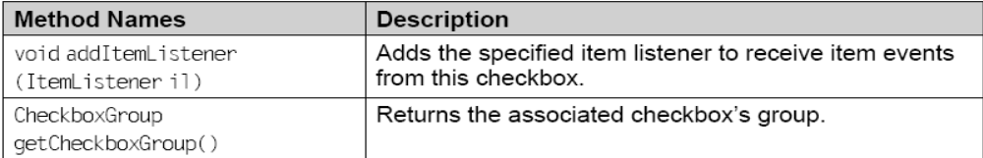
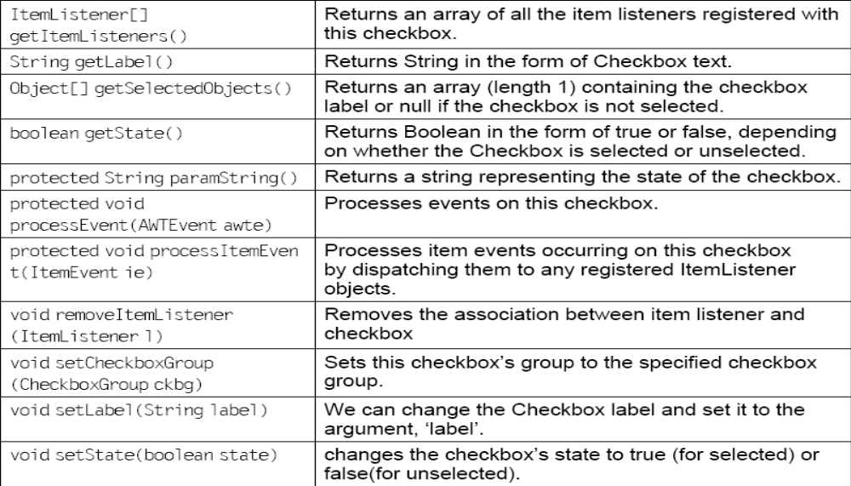
Methods of Checkbox class

Slide 21
Checkbox Example
/*<applet code=CheckboxClass.class width=400 height=100></applet>*/
import java.applet.*;
import java.awt.*;
import java.awt.event.*;
public class CheckboxClass extends Applet implements ActionListener {
Button submit;
Checkbox name1;
Checkbox name2;
Checkbox name3;
public void init(){
name1 = new Checkbox (“Ram”,null,false);
name2 = new Checkbox (“Ramesh”,null,false);
name3 = new Checkbox (“Naresh”,null,false);

Slide 22
Checkbox Example
Font f = new Font (“Arial”,Font.ITALIC,14);
submit = new Button(“SUBMIT”);
add(name1); add(name2); add(name3); add(submit);
submit.addActionListener(this); }
public void actionPerformed(ActionEvent ae) {
String str = ae.getActionCommand();
if (str.equals(“SUBMIT”)) repaint();}
public void paint (Graphics g) {
g.setFont(f);
g.setColor(Color.blue);
if (name1.getState())
g.drawString(“Ram”,50,60);
if (name2.getState())
g.drawString(“Ramesh”,50,80);
if (name3.getState())
g.drawString(“Naresh”,50,100); }}

Slide 23
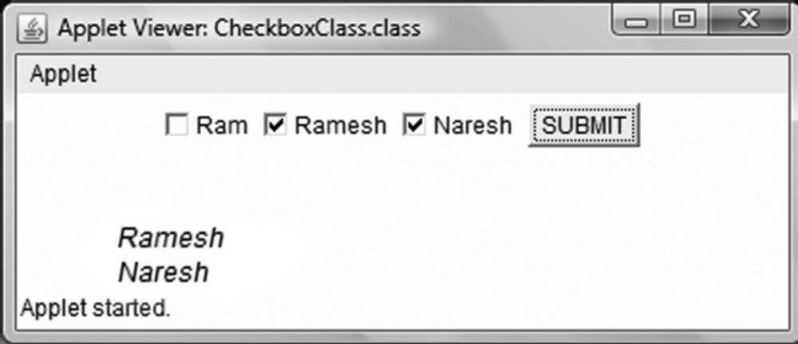
The Output

Slide 24
Radio Buttons
are special kind of checkboxes where only one box can be selected at a time.
The CheckboxGroup class is used to group together a set of checkboxes
  CheckboxGroup fruits = new CheckboxGroup();
After creating checkbox group, the individual checkboxes are added to that group.
  add(new Checkbox(“mango”, fruits, false));
  add(new Checkbox(“papaya”, fruits, false));
  add(new Checkbox(“guava”, fruits, false));
  add(new Checkbox(“apple”, true, yes));

Slide 25
Radio Button Example
/*<applet code=”RadioDemo.class” width=300 height=200></applet>*/
import java.applet.*; import java.awt.*;
import java.awt.event.*;
public class RadioDemo extends Applet implements ItemListener{
Checkbox red, white, green; CheckboxGroup cbg;
public void init(){
add(new Label(“The 4 radio buttons will change the screen color.”));
cbg = new CheckboxGroup();
red = new Checkbox(“Red”,cbg,false);
white = new Checkbox(“White”,cbg,false);
green = new Checkbox(“Green”,cbg,false);
add(new Label(“Notice that you can only select one radio button.”));
add(new Label(“And selecting a radio button triggers an event”));

Slide 26
Radio Button Example
add(new Label(“that we use to change the screen color.”));
add(red);
add(white); add(green);
red.addItemListener(this);
white.addItemListener(this);
green.addItemListener(this); }
public void itemStateChanged(ItemEvent ie){
String str = (String) ie.getItem();
if (str.equals(“Red”)) {
setBackground(Color.red);}
else if (str.equals(“White”)) {
setBackground(Color.white);}
else if (str.equals(“Green”)){
setBackground(Color.green);}
repaint();}}

Slide 27
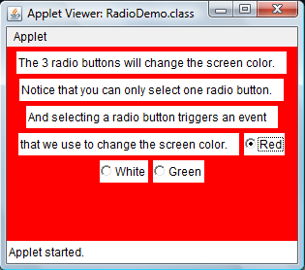
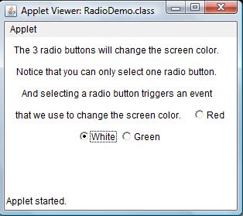
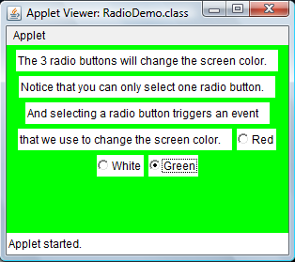
The Output

Slide 28
List
provides a multiple choice, scrolling list of values that may be selected alone or together
List class has the following constructors:
  List()
  List (int no_of_rows)
  List(int no_of_rows, boolean multi_select)
To create a List and add items to it
  List anyList = new List(10, true);
  anyList.add(“apple”);
  anyList.add(“mango”);
  anyList.add(“guava”);
  thelist.add(“Coffee”, 0); // adds at the first position

Slide 29
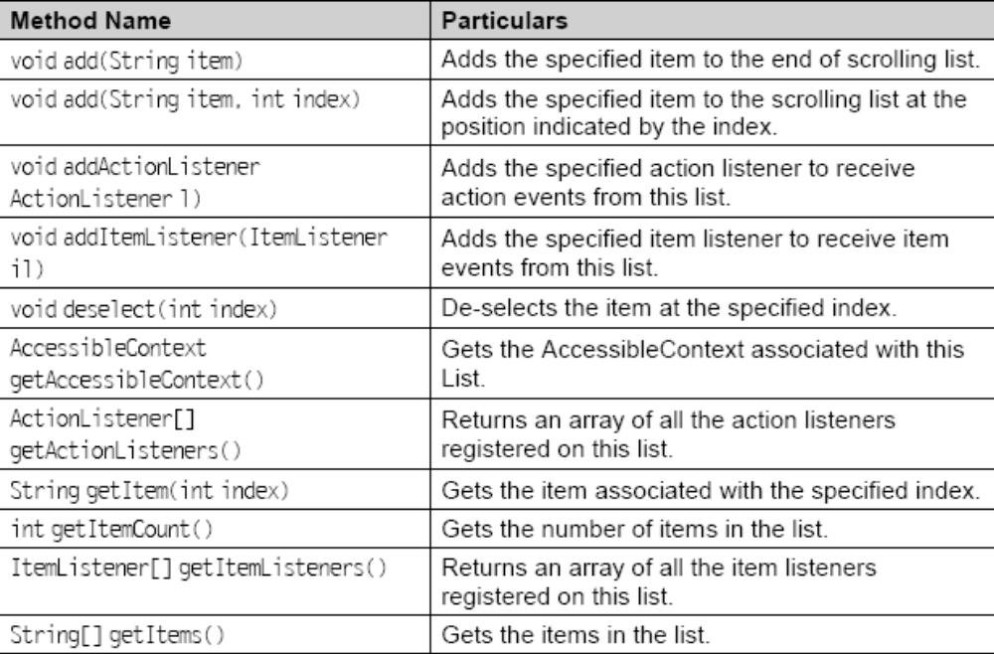
Few Methods of List class

Slide 30
Example
/*<applet code=ShopList.class width=600 height=600></applet>*/
import java.applet.*;import java.awt.*;import java.awt.event.*;
public class ShopList extends Applet implements ActionListener {
List original; List copy;
public void init(){
original= new List(8,false);
copy= new List(10,false);
populateList();
add(original);
Button b1 = new Button(“>>>>”);
add(b1); add(copy);
Button b2 = new Button(“Clear”);
add(b2);
add(new Label(“Select an item from the list on the left and hit >>>> to place it in the other list”));
b1.addActionListener(this); b2.addActionListener(this);}

Slide 31
Example
public void populateList(){
original.add(“Grocery”);
original.add(“Fruits”);
original.add (“Ice-cream”);
original.add(“Vegetables”);
original.add(“Garments”);
original.add(“Baby Food”);}
public void actionPerformed(ActionEvent ae){
String str = ae.getActionCommand();
if (str.equals(“>>>>”) && original.getSelectedIndex ()>=0) {
copy.add(original.getSelectedItem());
original.remove(original.getSelectedIndex());}
else if(str.equals(“Clear”)) {
original.removeAll();
copy.removeAll();
populateList(); }
repaint(); }}

Slide 32
Choice box
provides a pop-up menu of text string choices
current choice is displayed on top.
  Choice c = new Choice();
the add method enables you to add new entries.
  c.add(“Red”);
  c.add(“Green”);
The currently selected item can be changed by using select() method.
The selection can be made based on name or index. For e.g.
  c.select(“Red”);
  c.select(0);
  getSelectedIndex() - return the position of the selected item
  getSelectedItem() - returns the name of the selected item
The Listener for handling Choice change events is ItemListener.

Slide 33
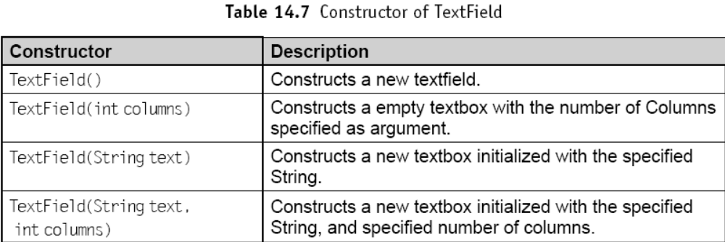
TextField and TextArea
The TextField class handles single line of text.
The TextArea is used for handling multiple lines of text.

Slide 34
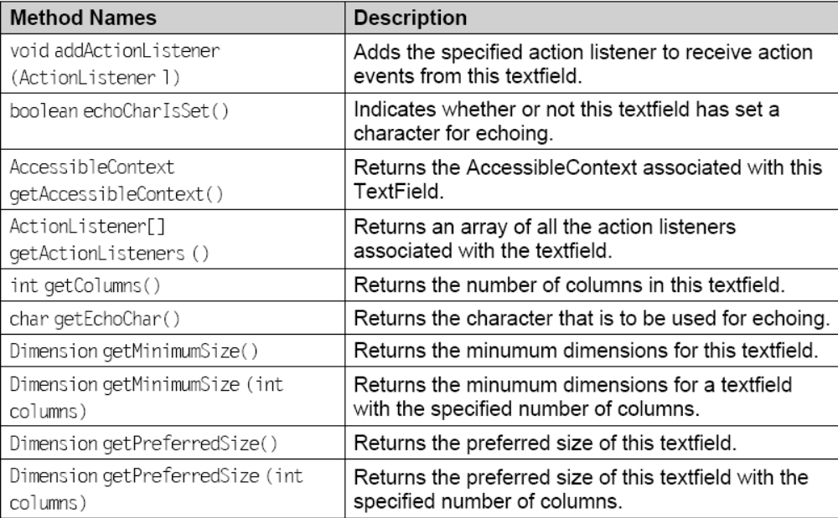
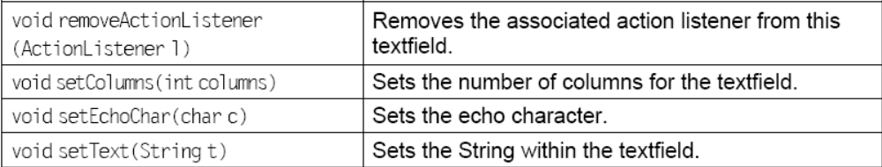
Methods of TextField

Slide 35
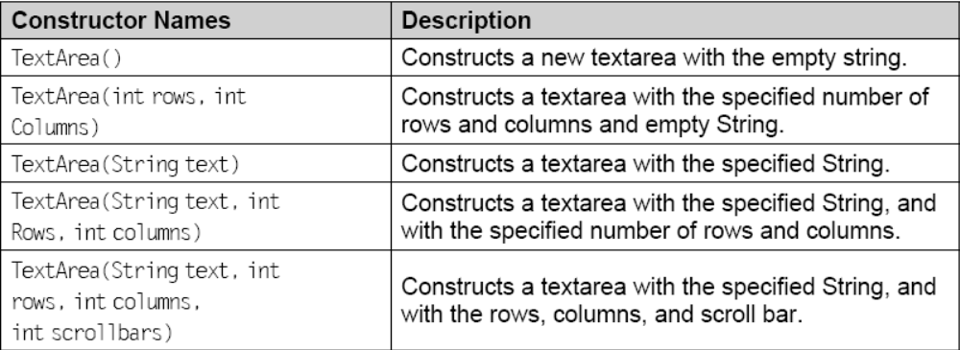
TextArea

Slide 36
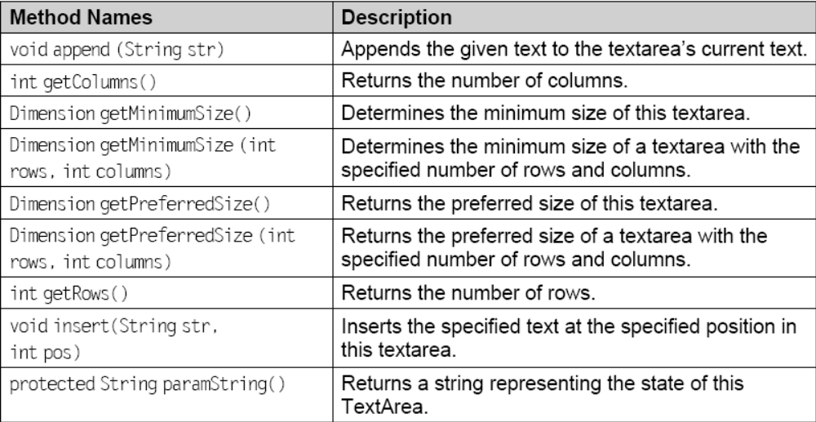
Few methods of TextArea

Slide 37
Container classes
Window
  Window is a top-level display surface. An object of Window class is not Attached to nor embedded within another container. An instance of the Window does not have border, title bar or menu.
Frame
  Frame is a top-level window with a border and title. An instance of the Frame class may have a menu bar, title bar and borders. It is otherwise like an object of the Window class.
Dialog
  Dialog is top-level display surface (a window) with a border and title. An object of the Dialog class cannot exist without an associated object of the Frame class.
Panel
  Panel is generic container for holding components. An instance of the Panel class provides a container to which components can be added. It does not add any new method; it simply implements the Container.

Slide 38
Layouts
FlowLayout
BorderLayout
GridLayout
GridbagLayout

Slide 39
FlowLayout
arranges components from left-to-right and top-to-bottom, centering components horizontally.
The direction of flow is determined by the container’s componentOrientation property.
  ComponentOrientation.LEFT_TO_RIGHT : Items run left to right and lines flow top to bottom, e.g. English, French, etc.
  ComponentOrientation.RIGHT_TO_LEFT : Items run right to left and lines flow top to bottom, e.g. Arabic, Hebrew, etc.
There is five pixel gap between the components arranged in this layout.
the default layout for the Applet.

Slide 40
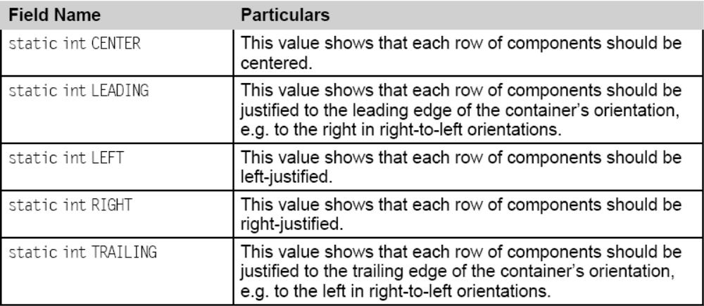
Fields of FlowLayout

Slide 41
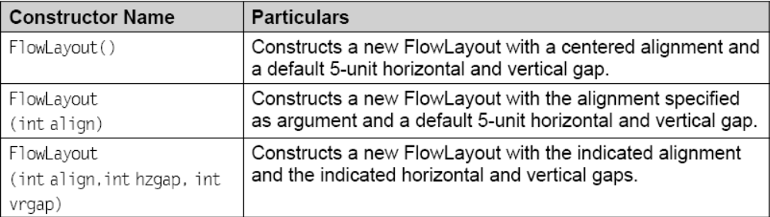
Constructors of FlowLayout

Slide 42
Example
/*<applet code=FlowLayoutDemo.class width=600 height=350></applet>*/
import java.applet.Applet; import java.awt.*;
public class FlowLayoutDemo extends Applet{
LayoutManager flowLayout;
Button [] Buttons;
public FlowLayoutDemo() {
int i;
flowLayout = new FlowLayout ();
setLayout (flowLayout);
Buttons = new Button [6];
for (i = 0; i < 6; i++) {
Buttons[i] = new Button ();
Buttons[i].setLabel (“Button “ + (i + 1));
add (Buttons[i]);}}}

Slide 43
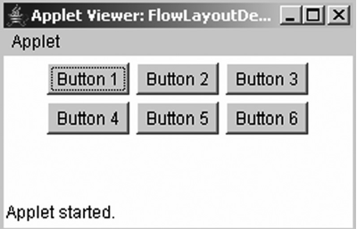
The Output

Slide 44
BorderLayout
This is the default layout of the Frame.
  public class BorderLayout extends Object implements LayoutManager2, Serializable
There can be only one component in each region and the regions are identified as constants:
  NORTH, SOUTH, EAST, WEST, and CENTER.
Any of these five constant names can be used while adding a component to a container.
  Panel pnl = new Panel();
  pnl.setLayout(new BorderLayout());
  pnl.add(new Button(“submit”), BorderLayout.NORTH);

Slide 45
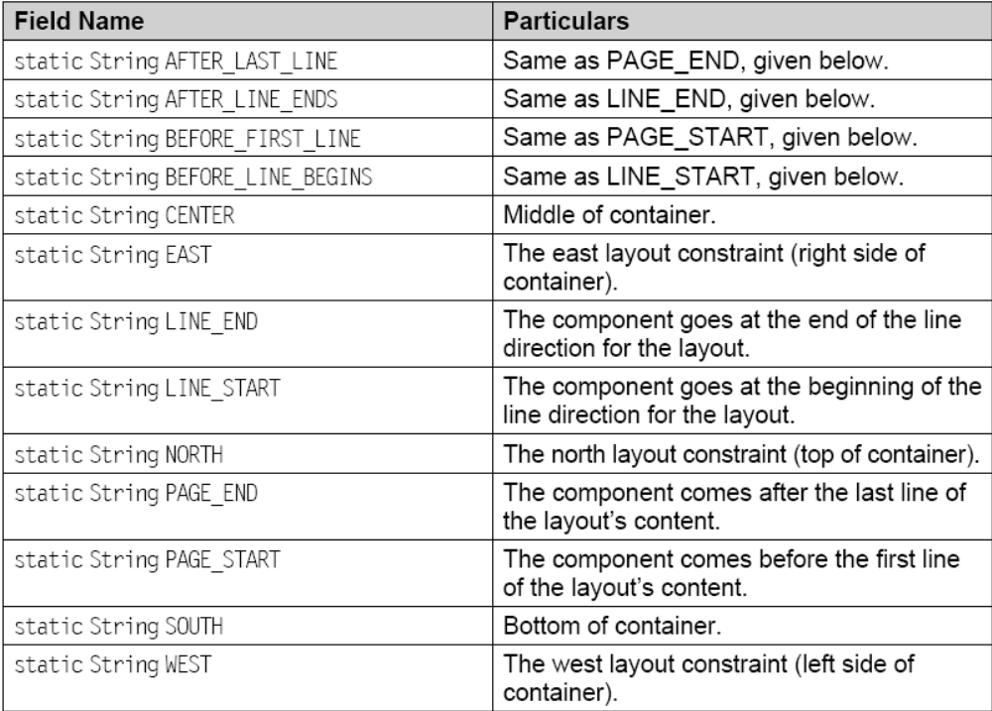
Fields of BorderLayout

Slide 46
Example
import java.awt.*;
public class BLayoutDemo extends Frame {
public BLayoutDemo(String title) {
super(title);
add(new Button(“North”),BorderLayout.NORTH);
add(new Button(“South”),BorderLayout.SOUTH);
add(new Button(“East”),BorderLayout.EAST);
add(new Button(“West”),BorderLayout.WEST);
add(new Button(“Center”),BorderLayout.CENTER);
setSize(400, 270);
setVisible(true);}
public static void main(String[] args) {
BLayoutDemo blaypout = new BLayoutDemo(“Border Layout Example”);}}

Slide 47
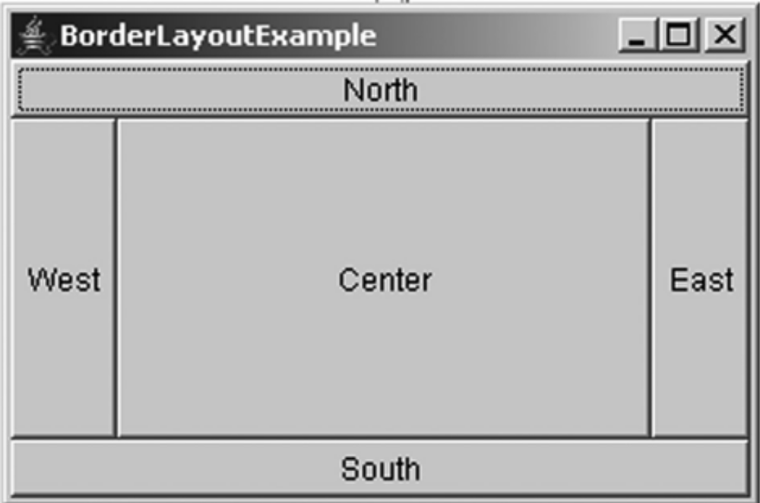
The Output

Slide 48
CardLayout
Each component is treated as a card by cardLayout object.
Each card kept on another like a stack and only one card can be visible at a time.
When the container is displayed after adding the first component, then the first component is visible.
The ordering of cards is determined by the container’s own internal ordering of its component objects.
CardLayout defines a set of methods that allow an application to flip through these cards sequentially, or to show a specified card.

Slide 49
Example
import java.awt.*;
import java.awt.event.*;
public class CardDemo extends Frame implements ActionListener {
Panel cardPanel; Panel p1, p2, p3; Panel buttonP;
Button B1,B2,B3; CardLayout cLayout;
public void cardDemo(){
cardPanel = new Panel();
cLayout = new CardLayout();
cardPanel.setLayout(cLayout);
p1 = new Panel();
p1.setBackground(Color.red);
p2 = new Panel();
p2.setBackground(Color.yellow);

Slide 50
Example (contd.)
p3 = new Panel();
p3.setBackground(Color.green);
B1 = new Button(“Red”);
B1.addActionListener(this);
B2 = new Button(“Yellow”);
B2.addActionListener(this);
B3 = new Button(“Green”);
B3.addActionListener(this);
buttonP = new Panel();
buttonP.add(B1);
buttonP.add(B2);
buttonP.add(B3);
cardPanel.add(p1, “B1”);
cardPanel.add(p2, “B2”);
cardPanel.add(p3, “B3”);
setLayout(new BorderLayout());

Slide 51
Example (contd.)
add(buttonP, BorderLayout.SOUTH);
add(cardPanel, BorderLayout.CENTER);
setVisible(true); setSize(300,200);
setTitle(“DemoCard”);
addWindowListener(new WindowAdapter(){
public void windowClosing(WindowEvent we){
System.exit(0);}});}
public void actionPerformed(ActionEvent e){
if (e.getSource() == B1)
cLayout.show(cardPanel, “B1”);
if (e.getSource() == B2)
cLayout.show(cardPanel, “B2”);
if (e.getSource() == B3)
cLayout.show(cardPanel, “B3”);}
public static void main(String a[]){
CardDemo demo=new CardDemo();
demo.cardDemo();} }

Slide 52
GridLayout
public class GridLayout extends Object implements LayoutManager, Serializable
lays out a container’s components in a rectangular grid.

Slide 53
Example
import java.awt.event.*;
import java.awt.*;
class GridLayoutDemo extends Frame{
public GridLayoutDemo() {
super(“Laying Out Components using GridLayout”);
Panel p = new Panel(new GridLayout(5,2, 20,50));
p.add(new Label(“Name”));
p.add(new TextField(5));
p.add(new Label(“Roll No”));
p.add(new TextField(3));
p.add(new Label(“Class”));
p.add(new TextField(3));
p.add(new Label(“Total Marks”));
p.add(new TextField(3));

Slide 54
Example (contd.)
p.add(new Button(“Submit”));
p.add(new Button(“Cancel”));
add(p);
setSize(400,400);
setVisible(true);
addWindowListener(new WindowAdapter(){
public void windowClosing(WindowEvent e){
System.exit(0);}});}
public static void main(String[] args) {
GridLayoutDemo g=new GridLayoutDemo();
}}

Slide 55
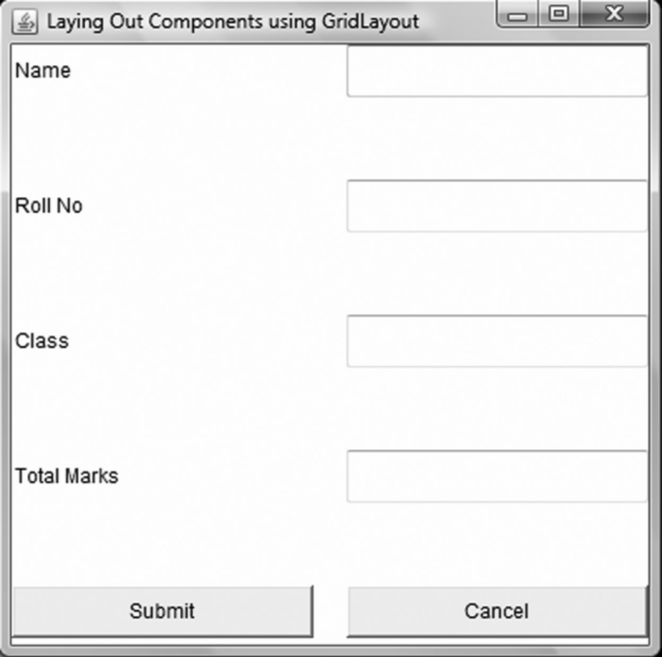
The Output

Slide 56
GridBagLayout
  We can arrange components in horizontal as well in vertical direction or by positioning them within a cell of a grid
components need not be of same size in a row.
each row can contain dissimilar number of columns.
GridBagConstraint contains the constraint which includes the
  height, width of a cell, placement and alignment of components.
GridBagLayout object maintains a rectangular grid of cell.
Component can occupy one or more cells, a.k.a its display area.

Slide 57
GridBagLayout
ComponentOrientation class controls the orientation of the grid.
We need to customize GridBagConstraints objects to use GridBagLayout effectively associated with its components.
Customization of a GridBagConstraints object can be doneby setting one or more of its instance variables.
  gridx & gridy
    The initial address of cell of a grid is gridx = 0 and gridy = 0.
  gridwidth & gridheight
    gridwidth constraint specifies the number of cells in a row and gridheight specifies number of columns in display area of the components. The default value is 1.

Slide 58
GridBagLayout (contd.)
  fill
    GridBagConstraints.NONE (default value–does not grow when the window is resized)
    GridBagConstraints.HORIZONTAL (this value fills all the horizontal display area of a component, but it does not change height).
    GridBagConstraints.VERTICAL (it changes the height of a component, but does not change its width)
    GridBagConstraints.BOTH (makes the component fill its display area horizontally and vertically, both).
  ipadx and ipady
    for internal padding of components in given layout.
  Insets
    used for spacing between the component and the edges of its display area
  anchor
    specifies the position of a component in its display area
  weight x & weight y
    used to distribute space (horizontal and vertical)

Slide 59
Example
import java.awt.*;
public class GBLayoutDemo1 extends Frame{
public GBLayoutDemo1(){
setLayout(new GridBagLayout());
setTitle(“GridBagLayout Without Constraints”);
Label l=new Label(“Name”);
add(l);
TextField t=new TextField();
add(t);
Button b=new Button(“Submit”);
add(b);
Button b1=new Button(“Reset”);
add(b1);
setSize(200,200); setVisible(true);}
public static void main(String args[]){
GBLayoutDemo1 d=new GBLayoutDemo1();}}

Slide 60
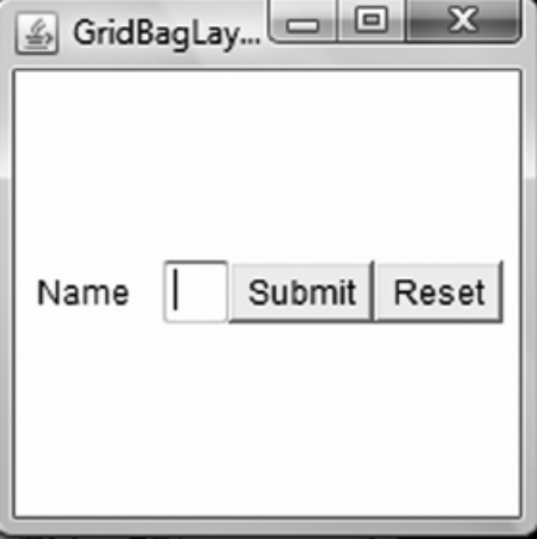
The Output

Slide 61
Menu
Menu is a class which inherits MenuItem class and two interfaces:
  MenuContainer and
  Accessible.
Menubar deploys a menu object which is a dropdown menu component.
  It shows a list of menu choices.
To implement this concept we use three classes:
  MenuBar,
  Menu, and
  MenuItem.

Slide 62
Example
import java.awt.event.*;
import java.awt.*;
public class DemoMenu extends Frame implements ActionListener{
public void demoMenu() {
setTitle(“MenuDemo”);
setSize(250,150);
MenuBar menuBar = new MenuBar();
setMenuBar(menuBar);
MenuShortcut n=new MenuShortcut(KeyEvent.VK_N);
MenuShortcut o=new MenuShortcut(KeyEvent.VK_O);
MenuShortcut x=new MenuShortcut(KeyEvent.VK_X);
Menu fileMenu = new Menu(“File”);
Menu editMenu = new Menu(“Edit”);
MenuItem newAction = new MenuItem(“New”,n);
MenuItem openAction = new MenuItem(“Open”,o);
MenuItem exitAction = new MenuItem(“Exit”,x);

Slide 63
Example (contd.)
MenuItem cutAction = new MenuItem(“Cut”);
MenuItem copyAction = new MenuItem(“Copy”);
MenuItem pasteAction = new menuItem(“Paste”);
newAction.addActionListener(this);
openAction.addActionListener(this);
exitAction.addActionListener(this);
fileMenu.addSeparator();
fileMenu.add(newAction);
fileMenu.addSeparator();
fileMenu.add(openAction);
fileMenu.addSeparator();
fileMenu.add(exitAction);
menuBar.add(fileMenu);
cutAction.addActionListener(this);
copyAction.addActionListener(this);

Slide 64
Example (contd.)
pasteAction.addActionListener(this);
editMenu.add(cutAction);
editMenu.addSeparator();
editMenu.add(copyAction);
editMenu.addSeparator();
editMenu.add(pasteAction);
editMenu.addSeparator();
menuBar.add(editMenu);
setVisible(true);
addWindowListener(new WindowAdapter(){
public void windowClosing(WindowEvent we){
System.exit(0);}}); }
public void actionPerformed(ActionEvent e) {
String action=e.getActionCommand();
if(action.equals(“New”)){
System.out.println(“New”);}

Slide 65
Example (contd.)
else if(action.equals(“Open”)){
System.out.println(“File”);}
else if(action.equals(“Exit”)){
System.exit(0);}
else if(action.equals(“Cut”)){
System.out.println(“Cut”);}
else if(action.equals(“Copy”)){
System.out.println(“Copy”);}
else if(action.equals(“Paste”)){
System.out.println(“Paste”);}}
public static void main(String[] args) {
DemoMenu demo= new DemoMenu();
demo.demoMenu();} }

Slide 66
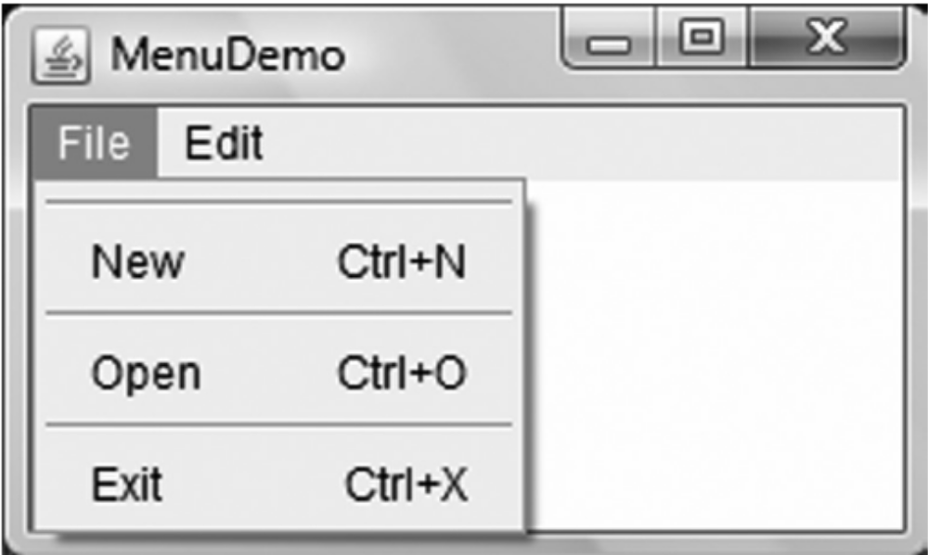
The Output

Slide 67
Scrollbar
Scrollbars are used to select continuous values through a range of integer values (the range set between maximum and minimum).
These scrollbars can either be set horizontally or vertically.
The scrollbar’s maximum and minimum values can be set along with line increments and page increments.
  Scrollbar() throws HeadlessException
  Scrollbar(int direction) throws HeadlessException
  Scrollbar(int direction, int initValue, int pageSize, int min, int max) throws HeadlessException

Slide 68
Example
import java.awt.*;
import java.awt.event.*;
public class ScrollbarDemo extends Frame implements AdjustmentListener { Scrollbar HScroll, VScroll;
Label lbl;
int X=100,Y=150;
public ScrollbarDemo () {
HScroll = new Scrollbar (Scrollbar.HORIZONTAL);
VScroll = new Scrollbar (Scrollbar.VERTICAL);
lbl = new Label (“”,Label.CENTER);
HScroll.setMaximum (400);
VScroll.setMaximum (400);
setBackground (Color.cyan);
setTitle(“Oval size changes with scrollbar movements”);
setLayout (new BorderLayout());
add (lbl,BorderLayout.NORTH);
add (HScroll,BorderLayout.SOUTH);

Slide 69
Example (contd.)
add (VScroll, BorderLayout.EAST);
HScroll.addAdjustmentListener (this);
VScroll.addAdjustmentListener (this);
HScroll.setValue (X); VScroll.setValue (Y);
lbl.setText (“HScroll = “ + HScroll.getValue() + “, VScroll = “ + VScroll getValue());
setSize(500,500); setVisible(true);
addWindowListener(new WindowAdapter(){
public void windowClosing(WindowEvent e){ System.exit(0);} });}
public void adjustmentValueChanged(AdjustmentEvent e) {
X=HScroll.getValue(); Y= VScroll.getValue ();
lbl.setText (“HScroll = “ + X + “, VScroll = “ + Y);
repaint();}
public void paint (Graphics g) {
g.drawOval (50, 60, X, Y); }
public static void main(String args[]) {
ScrollbarDemo d=new ScrollbarDemo();}}

Slide 70
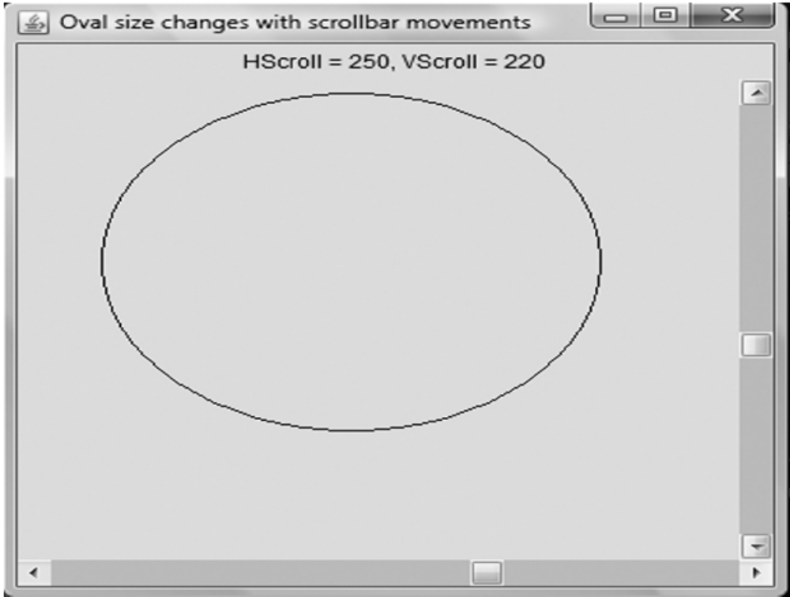
The Output

Slide 71
Summary
In this chapter we have emphasized on Graphical User Interface (GUI) for input and output.
Java has a package named as java.awt, having various classes responsible for generating various GUI frameworks.
These components include Button, Scrollbar, Choicebox, List, TextField, etc.
AWT defines ways to lay the AWT components in containers.
There are many layout managers in AWT like
  FlowLayout,
  GridLayout,
  GridBagLayout,
  CardLayout, etc,
Menu is a class that inherits MenuItem class and two interfaces: MenuContainer and Accessible.

